Slide 1

Breast Cancer Prediction Using Machine Learning ALGORITHMS
Machine Learning

Slide 2
Agenda
Group Member Information
Role/Responsibilities and Contribution in project
Motivation
Objectives
Related work
Problem Statement
Proposed Solution
Results/Simulations
References

Slide 3
Group Members
Gayathri Keshamoni - GXK24880
Laxman Reddy Nalla - LXN20710
Uday Kumar Kuppam - UXK97680
Vinay Kumar Avirneni - VXA45490

Slide 4
Responsibilities and Contribution in project
Uday and Gayathri have spent time evaluating and deciding on machine learning algorithms by referring to various papers and articles.
Laxma Reddy and Vinay oversaw dataset collection, preprocessing, EDA, and algorithm and ML model implementation.

Slide 5
Motivation
Breast cancer is the most common disease in women worldwide. In 2016, 246,660 new cases of invasive breast cancer are expected to be diagnosed in women in the United States, with 40,450 women expected to die. The UCI Wisconsin Machine Learning Repository Breast Cancer Dataset attracted many patients with multivariate attributes that were taken as a sample set.
Machine learning for medical diagnostic methods and diagnostic accuracy will be a major change in medical care in the future, and it is an unavoidable trend. In 2019, an estimated 268,600 cases of invasive breast cancer were diagnosed in women, with 2,670 cases diagnosed in men.
We propose a comparison of ML classification algorithms that can accurately predict the type of cancer in this Machine Learning Project.
We were captivated by the progression of breast cancer and its prognosis. A sizable number of patients with multivariate variables were drawn to the UCI Wisconsin Machine Learning Repository Breast Cancer Dataset and used as a sample set.

Slide 6
Objectives
The goal of this research is to propose a rule-based classification method using machine learning techniques for predicting different types of breast cancer survival.
Compare the accuracy of various classification algorithms for the breast cancer prediction problem.
Examine various classification algorithms that provide high accuracy for the breast cancer prediction problem.

Slide 7
Related work
A substantial amount of work has already been done in determining breast cancer using various methods. The researcher developed a new technique to aid in the detection of breast cancer. They propose Bayesian Networks and Support Vector Machines to aid in breast cancer detection. Machine Learning classifiers were compared in support of Breast Cancer treatment based on the quantity chosen method. One of the causes of breast cancer is a DNA alteration or mutation. The experimental results show that the SVM-RBF kernel outperforms other classifiers in terms of accuracy, with a score of 96.84% in the Wisconsin Breast Cancer (original) datasets. As classification techniques, we used SVM, KNN, Random Forest, Naive Bayes, and ANN.

Slide 8
Problem Statement
Breast cancer is one of the most common cancers in many countries, including India. Even though the endurance rate is high - with early diagnosis, 97% of women can live for more than 5 years - Statistically, the death toll from this disease has risen dramatically in recent decades. The main issue with its treatment is early detection. As a result, in addition to medicinal solutions, some Data Science solutions must be integrated to address the death-causing issue.
This analysis seeks to determine which features are most useful in predicting malignant or benign cancer, as well as to identify general trends that may aid us in model and hyperparameter selection. The objective is to determine whether the breast cancer is benign or malignant. To accomplish this, I used machine learning classification methods to fit a function that can predict the discrete class of new input.

Slide 9
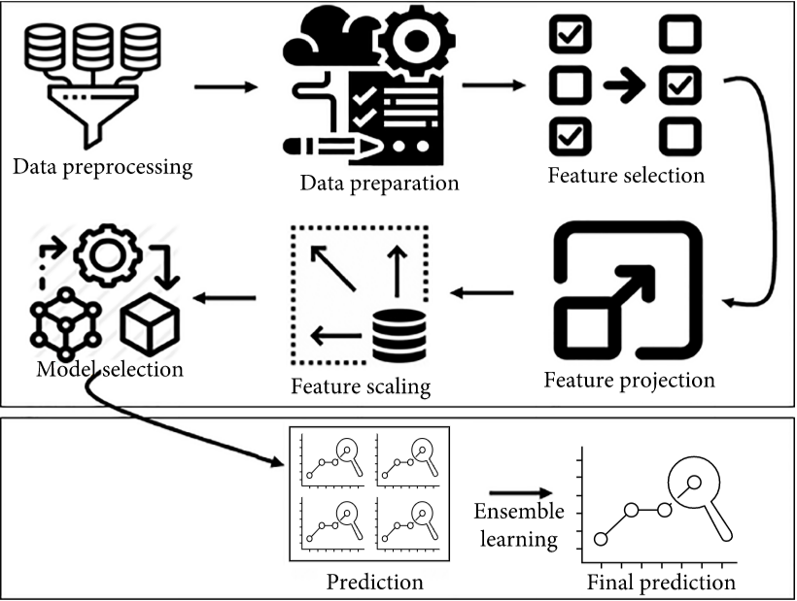
Proposed Solution
Data pre-processing is a data mining technique that involves converting raw data into a readable format. Real-world data is frequently insufficient, untrustworthy, and prone to errors.
Data preparation refers to the process of loading our data into the appropriate location and preparing it for use in machine-learning training.

Slide 10
Proposed Solution
In machine learning and statistics, feature selection refers to the process of selecting a subset of relevant characteristics to be used in the creation of a model, as well as the variable selection and attribute selection.
Using feature projection, data from a high-dimensional space is transformed into a lower-dimensional space (with fewer properties).
The Dataset will frequently contain features with a diverse range of magnitudes, units, and ranges. However, because most machine learning algorithms compute the Euclidean distance between two data points.
The model can be trained using historical data and then used to forecast the future using new data. They are classified into regression and classification
The prediction or inference step is where we get to answer various questions. This is the point at which the value of machine learning becomes apparent.

Slide 11
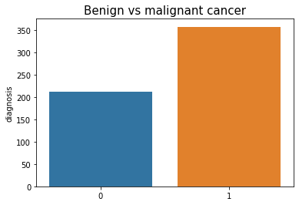
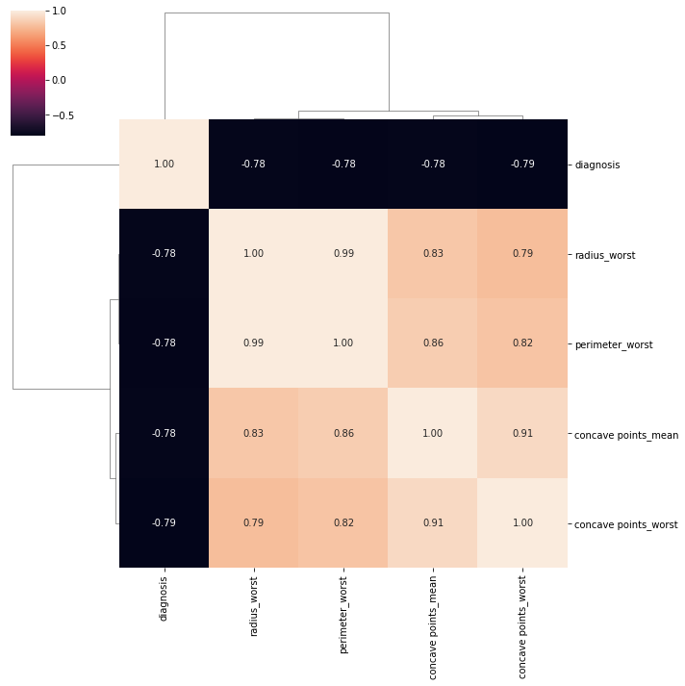
Data Description
Fig (a)
This study makes use of the Wisconsin Breast Cancer (Diagnostic) dataset. Both the dataset and the (CSV) file are available in Ref [15] and the UCI machine learning repository, respectively. MATLAB then converted the (CSV) file to (MAT) format. In brief, the dataset's characterization is provided below. The dataset contains 569 patterns, 357 benign and 212 malignant, divided into three classifications (ID number, benign, and malignant), with 32 columns for characteristics.
Fig (a) shows the Count of Benign and malignant cancer
Fig (b) shows the Correlation of features with a threshold > 0.75
Fig (b)

Slide 12
Results
Training and testing are divided by 70% and 30% in experimental studies, respectively. JUPITER includes machine learning techniques for pre-processing data, classification, regression, clustering, and association rules. To apply and test our classifiers, we use the 10-fold cross-validation test, a method for evaluating predictive models that divides the original set into a training sample to train the model and a test set to evaluate it.
Method | Accuracy % | Training Acc
SVM | 97.36 | 98.46
Decision Tree | 94.73 | 99.12
Logistic Regression | 96.49 | 98.46
KNN | 97.36 | 97.58
XG Boost | 98.24 | 99.78
Table : Accuracy Comparison with other methods

Slide 13
References
[1] Wang, D. Zhang and Y. H. Huang “Breast Cancer Prediction Using Machine Learning” (2018), Vol. 66, NO. 7.
[2] B. Akbugday, "Classification of Breast Cancer Data Using Machine Learning Algorithms," 2019 Medical Technologies Congress (TIPTEKNO), Izmir, Turkey, 2019, pp. 1-4.
[3] Keles, M. Kaya, "Breast Cancer Prediction and Detection Using Data Mining Classification Algorithms: A Comparative Study." Tehnicki Vjesnik - Technical Gazette, vol. 26, no. 1, 2019, p. 149+.
[4] V. Chaurasia and S. Pal, “Data Mining Techniques: To Predict and Resolve Breast Cancer Survivability”, IJCSMC, Vol. 3, Issue. 1, January 2014, pg.10 – 22.
[5] Delen, D.; Walker, G.; Kadam, A. Predicting breast cancer survivability: A comparison of three data mining methods. Artif. Intell. Med. 2005, 34, 113–127.
[6] R. K. Kavitha1, D. D. Rangasamy, “Breast Cancer Survivability Using Adaptive Voting Ensemble Machine Learning Algorithm Adaboost and CART Algorithm” Volume 3, Special Issue 1, February 2014
[7] P. Sinthia, R. Devi, S. Gayathri and R. Sivasankari, “Breast Cancer detection using PCPCET and ADEWNN”, CIEEE’ 17, p.63-65
[8] Vikas Chaurasia and S.Pal, “Using Machine Learning Algorithms for Breast Cancer Risk Prediction and Diagnosis” (FAMS 2016) 83 ( 2016 ) 1064 – 1069
[9] N. Khuriwal, N. Mishra. “A Review on Breast Cancer Diagnosis in Mammography Images Using Deep Learning Techniques”, (2018), Vol. 1, No. 1.
[10] Y. Khourdifi and M. Bahaj, "Feature Selection with Fast CorrelationBased Filter for Breast Cancer Prediction and Classification Using Machine Learning Algorithms," 2018 International Symposium on Advanced Electrical and Communication Technologies (ISAECT), Rabat, Morocco, 2018, pp. 1-6

Slide 14
References
[11] R. M. Mohana, R. Delshi Howsalya Devi, Anita Bai, “Lung Cancer Detection using Nearest Neighbour Classifier”, International Journal of Recent Technology and Engineering (IJRTE), Volume-8, Issue-2S11, September 2019
[12] Ch. Shravya, K. Pravalika, Shaik Subhani, “Prediction of Breast Cancer Using Supervised Machine Learning Techniques”, International Journal of Innovative Technology and Exploring Engineering (IJITEE), Volume8 Issue-6, April 2019.
[13] Haifeng Wang and Sang Won Yoon, “Breast Cancer Prediction Using Data Mining Method”, Proceedings of the 2015 Industrial and Systems Engineering Research Conference,
[14] Abdelghani Bellaachia, Erhan Guven, “Predicting Breast Cancer Survivability Using Data Mining Techniques”
[15] Juhyeon Kim, Hyunjung Shin, Breast cancer survivability prediction using labeled, unlabeled, and pseudo-labeled patient data, Journal of the American Medical Informatics Association, Volume 20, Issue 4, July 2013, Pages 613–618.
[16] N. Khuriwal and N. Mishra, "Breast cancer diagnosis using adaptive voting ensemble machine learning algorithm," 2018 IEEMA Engineer Infinite Conference (eTechNxT), New Delhi, 2018, pp. 1-5.
[17] M. Amrane, S. Oukid, I. Gagaoua, and T. Ensarİ, "Breast cancer classification using machine learning," 2018 Electric Electronics, Computer Science, Biomedical Engineerings' Meeting (EBBT), Istanbul, 2018, pp. 1-4.
[18] M. R. Al-Hadidi, A. Alarabeyyat, and M. Alhanahnah, "Breast Cancer Detection Using K-Nearest Neighbor Machine Learning Algorithm," 2016 9th International Conference on Developments in eSystems Engineering (DeSE), Liverpool, 2016, pp. 35-39.
[19] Kibeom Jang, Minsoon Kim, Candace A Gilbert, Fiona Simpkins, Tan A Ince, Joyce M Slingerland “WEGFA activates an epigenetic pathway regulating ovarian cancer-initiating cells” Embo Molecular Medicines Volume 9 Issue 3 (2017)
[20] SA Medjahed, TA Saadi, A Benyettou “Breast cancer diagnosis by using k-nearest neighbor with different distances and classification rules” International Journal of Computer Applications 62 (1), 2013

Slide 15
Thank you

